Slide 1
Records and Registration Training for Faculty
Revised: May 2019

Slide 2
Registration Process
Time tickets are assigned based on several variables including but not limited to: number of hours enrolled term over term (progress toward degree), student classification and number of UNF hours earned
Registration overrides (prerequisites, special permission, etc.) are handled by advisors and departments
Summer and Fall registration run simultaneously
Transients, Senior Citizens, and Non-degree student have specific registration days (see Academic Calendar)
Chairs manage section enrollment capacities and waitlists

Slide 3
Waitlist Process
Students must choose to add themselves to a waitlist (WL); this can only be done through the 3rd day of add/drop
Automatic job runs on even hours through 4th day of add/drop week to move students from the WL into open seats
Only Chairs initiate waitlist moves on the final day of add/drop
Drops from the waitlist are completed by the Registrar the day after add/drop ends

Slide 4
First Day Non-Attendance
Students may be dropped during add/drop week for non-attendance
Students dropped for first day non-attendance at department/instructor discretion
Should be completed even if there is no waitlist
This is done in self-service > Admin Apps> Drop for Non-Attendance
Departments should e-mail students who have been dropped

Slide 5
Late Registration
Through third week of the semester via the Late Registration/Course Transfer Form
Must be signed by Advisor, Instructor, and Chair and submitted in-person to One-Stop
$100 late registration fee
$100 late payment fee
Must confirm fire code adherence

Slide 6
Course Transfer
Request for Course Transfer does not result in additional fee
Students may switch sections of the same course OR move to a pre-req or beginner course if not prepared for the current course
Course transfer period is after add/drop week. Timeframe varies from 2-3 weeks. Refer to the Academic Calendar for specifics
Room Capacity/Fire Code adherence must be confirmed!
Students cannot course transfer between terms or parts of term (e.g. Summer A to Summer B)

Slide 7
Administrative Drop for Non-Payment
Any financial transaction prevents an administrative drop for non-payment
Students MUST drop and not rely on administrative drop for non-payment
Reinstatement allowed through the third week of the term (refer to Academic Calendar for specific dates)
Must reinstate into ALL open classes
Closed classes are not reinstated
Re-registration fee = $100

Slide 8
Academic Activity Tracking
The US Department of Education (ED) requires institutions to document whether or not a student initiated attendance in enrolled courses for which the student receives Title IV aid by performing and documenting an academically-related activity.
Students who are not marked as having engaged in academic activity by the end of the second week of classes cannot and will not be provided federal aid for that course regardless of enrollment status.

Slide 9
Academic Activity Tracking
Academically related activities | Academically related activities for distance-education courses
Physically attending a class where there is an opportunity for direct interaction between instructor and students | Submission of an academic assignment
Submitting an academic assignment | Submission of an exam
Taking an exam, completing an interactive tutorial or participating in computer- assisted instruction | Documented participation in an interactive tutorial or computer-assisted instruction
Attending a study group that is assigned by the school | A posting by the student showing the student’s participation in an online study group that is assigned by the institution
Participating in an online discussion about academic matters | A post by the student in a discussion forum showing the student’s participation in an online discussion about academic matters
Initiating contact with a faculty member to ask a question about the academic subject studied in the course | An email from the student or other documentation showing that the student initiated contact with a faculty member to ask a question about the academic subject studied in the course
NOTE: Logging into an online class without active participation, participating in academic counseling or advisement, living in institutional housing, and participating in the school’s meal plan are not considered academic activities.

Slide 10
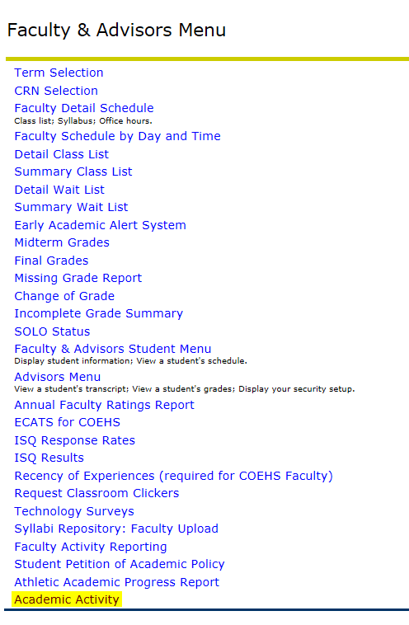
Academic Activity Tracking
From the Academic Activity screen:
Select the Term
Select the Part of Term
Select the Course
Click Submit (this will pull up a list the currently enrolled students for the CRN)

Slide 11
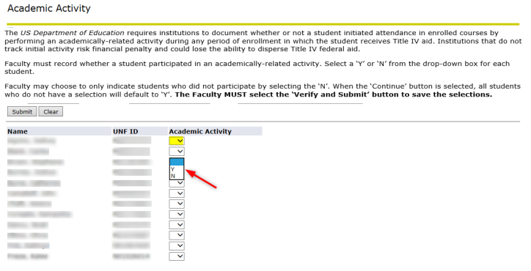
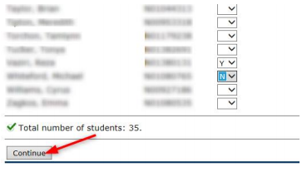
Academic Activity Tracking
Use the drop down button to select Y or N for each student in the course section.
Faculty may choose to only indicate students who did not participate by selecting the N and then select Continue to populate all the Y students at once.
Once Academic Activity has been recorded, scroll to the bottom and select Continue.

Slide 12
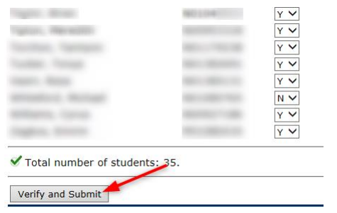
Academic Activity Tracking
After selecting Continue, a message will appear “The selections have not been saved. Select the Verify and Submit button to save.” All blank selections will change to Y. Once the selections have been reviewed, you must scroll to the bottom and select Verify and Submit.
NOTES:
All N selections will continue to show in a drop down button until the deadline.
N selections may be changed from N to Y until the deadline. Y selections may not be changed once submitted.
If all selections are Y, then no buttons are displayed.

Slide 13
Academic Activity Tracking
Deans and Chairs have access to an Academic Activity Report by Course which can be sorted and exported to Excel. Instructions for running this report can be found on our Faculty/Staff Resources page: https://www.unf.edu/onestop/registrar/Faculty_and_Staff_Resources.aspx
or by clicking here.
IMPORTANT: Students who late register, course transfer, and/or reinstate will need to have their academic activity tracked. Therefore, in some cases, an instructor who has already completed academic activity tracking for their course(s) will need to go back into the screen to complete tracking for the students who have had changes to their registration since the instructor first completed the process.

Slide 14
Student Petition of Academic Policy
Online process
Petition options include:
Extend the Late Registration Deadline
Extend the Course Transfer Deadline
Withdrawal After the Deadline
Exceed the Undergraduate Course Withdrawal Limitation Policy
Graduate with Fewer than 120 Credit Hours
Graduate with Fewer than 48 Upper Level Credit Hours
Waive the Board of Governors Summer Session Enrollment Requirement
Policies and Regulations that may not be petitioned can be found here.

Slide 15
Academic Misconduct
Unforgivable F (Punitive F)
“FA” grade on transcript
Cannot use grade forgiveness
Form and policy information on web
Academic Misconduct Policy
Faculty Handbook
Transcript notation in certain cases

Slide 16
Course Withdrawal Limit
Degree-seeking and non-degree seeking undergraduate students (including post-bac) are limited to the following:
Three (3) withdrawals for 1000/2000 level courses
Three (3) withdrawals for 3000 level or higher courses
Medical withdrawals, withdrawals for military service, etc are excluded from withdrawal limit
WP and WF grades count in withdrawal total
Effective for courses taken Fall 2013 or later; courses taken Summer 2013 and earlier DO NOT count in the total
No withdrawal limit for graduate students

Slide 17
Final Exam Schedule
Final exam schedule in Fall/Spring terms, no finals week in Summer (finals may be given on the last day)
Schedule is posted online
http://www.unf.edu/onestop/registrar/Registrar_-_Final_Exam_Schedule.aspx
Exam time is based on the day and time your class starts
1 hour, 50 minutes regardless of credit hours
Not obligated to give a final but must inform students before withdrawal deadline if no final will be given

Slide 18
Grading
Grading deadline is the second business day after the end of the term – Tuesday – 10am
Grades not submitted by deadline are “NR”
Last Date of Attendance is required for Failing and Incomplete grades
Late grades are submitted via Change of Grade by instructor – sent to chair queue for final approval
Missing Grades
Audit students receive “X” grade only

Slide 19
Incomplete Grades
Available for students who have completed a majority of the course and are able to submit remaining work
Grades of Incomplete will default to a one-year extension – can be shortened
Default grade is “F” but can be modified
Students are prohibited from re-registering for same course until Incomplete is resolved
Will be dropped by Registrar’s Office if not resolved and still registered

Slide 20
Change of Grade
Change a recorded grade for a student after final grading period is over
Faculty & Advisors Menu > Change of Grade
Select new grade, enter a Reason, and click on Update
Change will go to Chair queue for approval
All grade changes occur on this screen, including final evaluative grades for Incompletes

Slide 21
FERPA for Faculty
FERPA for Faculty webpage
http://www.unf.edu/onestop/registrar/FERPA_-_Faculty.aspx
Presentations can be given to departments or groups by Records staff, upon request
Confidentiality of student records is critical- particularly grades and UNF email addresses
Refer requests for student information to Registrar’s Office
FERPA Agreement in myWings- must be completed prior to being granted certain access to student data

Slide 22
Registrar’s Office Contacts
General e-mail box
records@unf.edu
University Registrar, Chad Learch
Assistant Registrar/University Scheduler, Jillian Gooding
Assistant Registrar, Angela Tlack
Resources
http://www.unf.edu/onestop/registrar/
Faculty and Staff Resources page

