Slide 1
Records and Registration Processes
Common Issues for
Office Managers & Administrative Secretaries
Revised: June 2018

Slide 2
Registration Begins
Time Tickets
Tickets assigned by number of UNF hours earned
Priority registration for Honors, Veterans, Athletes
Course Schedule Postings (subject to change)
Spring – Late October
Summer – Early March
Fall – Late March

Slide 3
No Time Ticket/SR
If the student doesn’t see a time ticket in myWings
Not admitted
Not active
Broken continuous enrollment & needs to re-apply
Exception: Students who attempt to register during add/drop week during what would have been their 3rd un-enrolled term may be re-activated without re-admission
SR indicates that a student is accessing the course schedule before his/her time ticket.
SR will disappear once registration is active for that student.

Slide 4
Prerequisite Processing
Once grades post for a term, the Registrar’s Office will run a process to identify who failed to pass a required prerequisite for a course in which they are enrolled for the next term.
An email will be sent to authorized users at the colleges/departments to notify you that the list is ready for review in self-service.
Authorized users will have the ability to drop students from classes that required a prerequisite that the student failed to pass (failed, withdrew, incomplete grade).

Slide 5
Prerequisite Processing
Microsoft Excel Spreadsheets will no longer be disseminated among colleges/departments for review.
Also, colleges/departments no longer have to send an email with the list of students who need to be dropped from future-term coursework for failure to pass a required prerequisite.
By taking no action, the student will be permitted to remain enrolled in the listed course despite failure to pass the prerequisite.

Slide 6
Prerequisite Processing

Slide 7
Prerequisite Processing

Slide 8
Prerequisite Processing

Slide 9
Prerequisite Processing

Slide 10
Registration Overrides
Registration overrides are granted on SFASRPO
Pre-req, time, spec appr, level, class, college, program, duplicates, field, etc.
Multiple overrides may be necessary
Duplicates override doesn’t work if there’s a waitlist
SPEC APPR used for AA (Advisor Approval) & DP (Department Permission) restrictions
Can give override by course or specific CRN

Slide 11
Granting an Override

Slide 12
Override Codes
COREQ: Co-requisite Override- course has a co-requisite not currently on the student’s registration.
PREREQ: Prerequisite Override- course has a prerequisite or minimum test score requirement that has not been met based on the student’s academic history.
TIME: Time Conflict Override- course is offered at the same time another CRN on the student’s schedule is being taught.
SPEC APPR: Special Approval Permission- course needs instructor, departmental or advisor approval.
LEVEL: Level Override- course has a level restriction different from the student’s level (e.g. UG student requesting a GR class).
DUPLICATES: Duplicates Override- course is a duplicate course number for the same term (e.g. special topics, DIS, thesis, etc.)
REPEAT HOU: Repeat Hours Override- course cannot be repeated for more than a specific number of credit hours; may be needed when student is attempting course for a second time to achieve a minimum program grade.
REPEAT LIM: Repeat Limit Override- course cannot be repeated for more than a specific number of times.

Slide 13
Override Codes
STU ATTR: Student Attribute Override- course is restricted to student’s with a specific attribute which cannot be found on the student’s record (e.g. NAUY-Honors).
CLASS: Classification Override- course is restricted to a particular classification of student (e.g. junior, senior, etc.).
COLLEGE: College Override- course is restricted to a particular college or colleges.
PROGRAM: Program Override- course is restricted to a particular degree program.
FIELD: Field of Study Override- course is restricted to a particular field of study. (Major, Minor, and/or Concentration)
DEGREE: Degree Override- course is restricted to a particular degree.
DEPT: Department Override- course is restricted to a particular department or departments.
MUTUAL: Mutual Exclusion Override- course is similar in content to another course a student has taken but is not considered to be an equivalent course as defined on SCAMEXC.

Slide 14
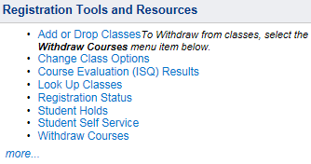
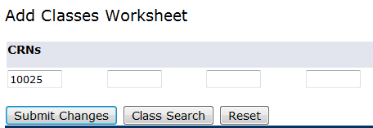
How to Add to a Wait list
Student selects the Add or Drop Classes option on the myWings Registration Tools & Resources menu.
Student enters the CRN in an empty box at the bottom of the worksheet

Slide 15
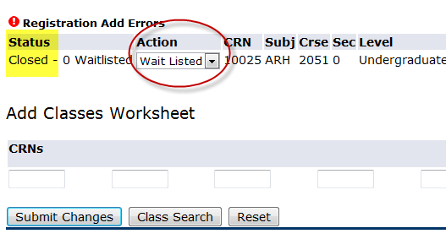
How to Add to a Wait list
Student sees error message that the class is Closed
Student selects Wait Listed from the Action menu
Student clicks Submit Changes to Save.

Slide 16
How to Add to a Wait list
Student will see Wait Listed in Status area
To drop from a wait list, the student must select Web Drop/Full Refund from the Action menu & Submit Changes

Slide 17
Automatic Wait list Job
Automatic job runs every two hours on even hours to place Wait Listed students into open seats
Job runs each day from the first day of a registration period through the 4th day of add/drop week
Only manual moves by department chairs are completed on the final day of add/drop week
Students receive auto email upon movement from wait list into class section
NOTE: Students may place themselves on a wait list from the first day of a registration period through the 3rd day of add/drop week

Slide 18
Common Wait list Issues
Student gets message that a class is Open but has a wait list
Automatic wait list job hasn’t run since a student dropped the class – will show as Closed once job runs
Student doesn’t move off of wait list or is dropped from a wait list
Maximum hours have been reached
Already in another section of the Wait Listed course
Doesn’t meet registration criteria – registration prevented due to restrictions or pre-requisites attached to class
In another section with different title but the same course number (special topics)

Slide 19
Enrollment Capacity Management
Department chairs can raise/lower enrollment and wait list caps via Department Browse
Click on caps to make adjustments

Slide 20
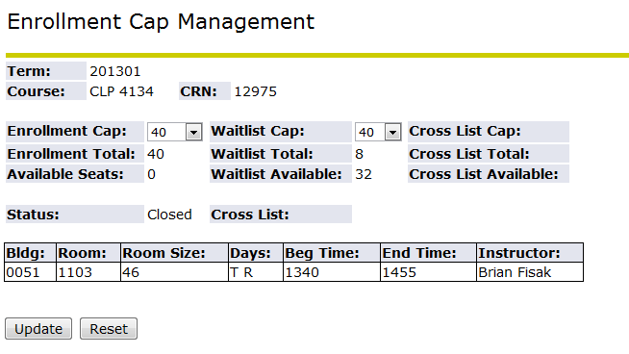
Enrollment Capacity Management
Enrollment Cap drop down menu goes up to room cap
Wait list Cap drop down menu goes up to 100

Slide 21
Administrative Drops for Non-Attendance
Students dropped for first day non-attendance at department/instructor discretion
This is completed in self-service > Admin Apps> Drop for Non-Attendance
Departments should e-mail students who have been dropped
Contact Chad, Jillian, or Valerie for access

Slide 22
Late Registration
Late Registration fee – $100
For any student who registers for a class via the Request for Late Registration form during the two weeks after add/drop week
For any student who has zero registration hours for the term when add/drop week begins and registers during that week

Slide 23
Course Transfer
Request for Course Transfer does not result in additional fee
Students may switch sections of the same course OR move to a pre-req or beginner course if not prepared for the current course
Course transfer period is after add/drop week. Timeframe varies from 2-3 weeks. Refer to the Academic Calendar for specifics
Room Capacity/Fire Code adherence must be confirmed!

Slide 24
Administrative Drop for Non-payment
Students who have no payment on their account for the term and no pending financial aid may be administratively dropped for non-payment
Any financial transaction prevents an administrative drop for non-payment
Students MUST drop classes they do not want and NOT rely on an administrative drop for non-payment

Slide 25
Reinstatement
Re-Registration fee - $100
Students who were administratively dropped for non-payment and want to re-register must reinstate into all previously registered classes (closed classes are not reinstated)
Reinstatement period starts after the administrative drop for non-payment and generally runs through the end of the 3rd week of classes. Refer to the Academic Calendar for specific dates
Reinstated students must pay immediately and may be administratively dropped again if payment is not received or aid is not pending

Slide 26
Course Withdrawal Limits
Degree-seeking and non-degree seeking undergraduate students (including post-bac) are limited to the following:
Three (3) withdrawals for 1000/2000 level courses
Three (3) withdrawals for 3000 level or higher courses
Medical withdrawals, withdrawals for military service, etc. are excluded from withdrawal limit
WP and WF grades count in withdrawal total
Effective for courses taken Fall 2013 or later; courses taken Summer 2013 and earlier DO NOT count in the total
No withdrawal limit for graduate students

Slide 27
Withdrawal Screen for Students

Slide 28
DIS Course Titles
UNF Administrative Applications > Student Maintenance > Independent Study Titles Input – Departmental View
May be submitted at any time during the semester
Transcripts are updated with individual titles after semester has rolled to academic history
Contact University Scheduler for access, if needed

Slide 29
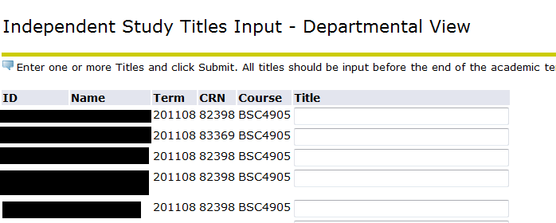
DIS Course Titles

Slide 30
Faculty Alpha List (FAL)
UNF Administrative Applications > Catalog Schedule > Faculty Alpha List
One week submission window in fall/spring – longer in summer due to multiple parts of term
Percentages of responsibility must total 100%
Institutional Research loads the FAIR system after completion

Slide 31
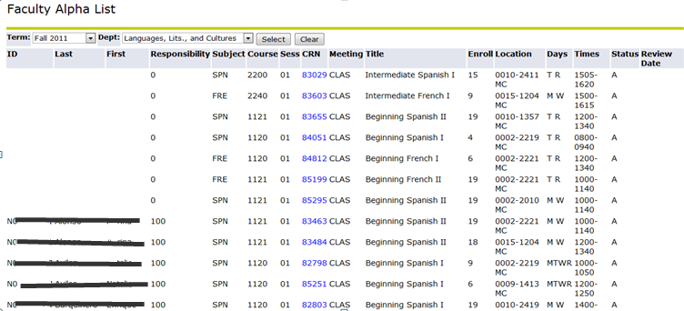
Faculty Alpha List (FAL)
Click CRN to enter instructor information

Slide 32
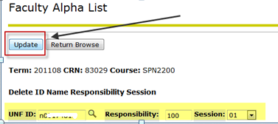
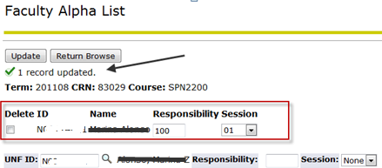
Faculty Alpha List (FAL)
Enter instructor N number, percentage of responsibility, and session – Click Update
*** Entry must equal 100% to be saved, so you will get an error message until all instructors are entered (if there are multiple instructors). ***

Slide 33
Contact Information
Records email box: records@unf.edu
University Registrar – Chad Learch
Assistant Registrar – Valerie Walker-Biggins
Assistant Registrar, University Scheduler – Jillian Gooding
Major Changes/Enrollment Verifications – Simone Wilson
Transcripts & Priority Registration – Matt Holcombe
Athletic Certification – Jeremy Baker
APC and Excess Hours – Allison Montero
Articulation & Enrollment Reporting- Angela Tlack

