Slide 1
Records and Registration Training for Department Chairs
Revised: January 2019

Slide 2
Topics
Prerequisites- pg. 3
Registration Restrictions- pg. 4
Registration Overrides- pgs. 5-6
Waitlists- pgs. 7-9
Enrollment Capacity Management- pgs. 10-11
Administrative Drop for Non-attendance- pg. 12
Late Registration- pg. 13
Course Transfer- pg. 14
Administrative Drop for Non-payment- pg. 15
Reinstatement- pg. 16
Academic Activity Tracking- pgs. 17-22
Course Withdrawal Limits- pgs. 23-24
Petitions and Forms- pg. 25
Academic Misconduct- pg. 26
Grading- pgs. 27-30
Suspension Processing- pgs. 31-33
DIS Course Titles- pgs. 34-35
Faculty Alpha List (FAL)- pgs. 36-38
SIS Reports- pg. 39
FERPA- pg. 40

Slide 3
Prerequisites
New prerequisites and prerequisite changes should be completed prior to registration period
Can choose to NOT check a prerequisite but formal removal requires APC
Submit the Non-APC Change Request Form in self-service (Administrative Applications > Catalog Schedule > Non-APC Change Request)
Can drop registered students for lack of prerequisites after end of prior term
Report/E-mails to Records@unf.edu

Slide 4
Registration Restrictions
Can be by: College, Department, Field of Study (Major/Minor/Concentration), Class, Level, Degree, Program
Student Attribute – currently Honors sections only
Use as few restrictions as possible to avoid multiple registration add errors
Advising directors can adjust sections; submit a Non-APC Change Request for catalog updates
Special Approval – can be granted by Department or Advisor

Slide 5
Registration Overrides
SFASRPO – Student Registration Permit-Override
Prerequisite (PREQ), Co-requisite (CORQ), Time, Special Approval (SPEC APPR), Level (LEVL), Class (CLAS), College (COLL), Program (PROG), Duplicates (DUPL), Field of Study/Major (FIELD), Degree (DEGR)
Can give override by Course or CRN
User N number is recorded
Always follow up with student

Slide 6
SFASRPO
To add an override, insert a new record to add an override by clicking the You can enter the override name on the line or search available overrides by clicking the ellipsis next to the field
You can enter the override course CRN or Subject and Course Number and all are searchable using the ellipsis function. Click Save in the bottom right to complete the process.
A green message will appear in the top right as confirmation. Messages are coded by color and numbered to help users. You can click the number to acknowledge and remove the message.
*For more details, see the Registration Override documentation posted to our Faculty/Staff Resources page.

Slide 7
Waitlists
Managing waitlists help maximize course enrollment
Automatic job runs on even hours from the first day of registration through 4th day of add/drop
Only Chairs initiate waitlist moves on final add/drop day
Students receive auto email upon movement from wait list into class section
NOTE: Students may place themselves on a wait list from the first day of a registration period through the 3rd day of add/drop week
Drops from the waitlist occur after add/drop ends – save your list of waitlisted students or compare against the drop list send by Records

Slide 8
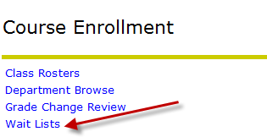
Waitlists
UNF Administrative Applications > Course Enrollment
Select Term and Department, then click Select

Slide 9
Waitlists

Slide 10
Enrollment Capacity Management
UNF Administrative Applications > Course Enrollment >Department Browse
Change Enrollment and Waitlist Caps up to room capacity by clicking on caps
Contact college scheduler if new room is needed to accommodate enrollment cap increase

Slide 11
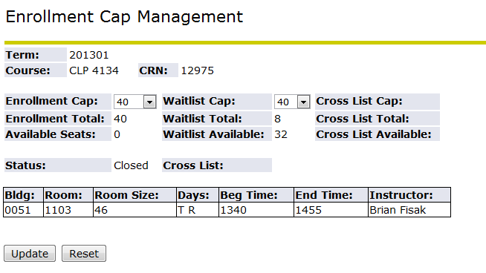
Enrollment Capacity Management
Enrollment drop down menu up to room capacity
Waitlist drop down menu up to 100

Slide 12
Administrative Drop for Non-Attendance
Should be completed even if there is no waitlist
Students dropped for first day non-attendance at department/instructor discretion
This is completed in self-service > Admin Apps> Drop for Non-Attendance
Departments should e-mail students who have been dropped
Contact Records for access

Slide 13
Late Registration
Through third week of the semester
$100 late registration fee
$100 late payment fee
Must confirm fire code adherence
Late Registration/Course Transfer Form

Slide 14
Course Transfer
Request for Course Transfer does not result in additional fee
Students may switch sections of the same course OR move to a pre-req or beginner course if not prepared for the current course
Course transfer period is after add/drop week. Timeframe varies from 2-3 weeks. Refer to the Academic Calendar for specifics
Room Capacity/Fire Code adherence must be confirmed!
Students cannot course transfer between terms or parts of term (e.g. Summer A to Summer B)

Slide 15
Administrative Drop for Non-Payment
Any financial transaction prevents an administrative drop for non-payment
Students MUST drop and not rely on administrative drop for non-payment
Reinstatement - $100 re-registration fee
No guarantee a student will get back into all dropped courses

Slide 16
Reinstatement
Re-Registration fee - $100
Students who were administratively dropped for non-payment and want to re-register must reinstate into all previously registered classes (closed classes are not reinstated)
Reinstatement period starts after the administrative drop for non-payment and generally runs through the end of the 3rd week of classes. Refer to the Academic Calendar for specific dates
Reinstated students must pay immediately and may be administratively dropped again if payment is not received or aid is not pending

Slide 17
Academic Activity Tracking
The US Department of Education (ED) requires institutions to document whether or not a student initiated attendance in enrolled courses for which the student receives Title IV aid by performing and documenting an academically-related activity.
Students who are not marked as having engaged in academic activity cannot and will not be provided federal aid for that course regardless of enrollment status.

Slide 18
Academic Activity Tracking
Academically related activities | Academically related activities for distance-education courses
Physically attending a class where there is an opportunity for direct interaction between instructor and students | Submission of an academic assignment
Submitting an academic assignment | Submission of an exam
Taking an exam, completing an interactive tutorial or participating in computer- assisted instruction | Documented participation in an interactive tutorial or computer-assisted instruction
Attending a study group that is assigned by the school | A posting by the student showing the student’s participation in an online study group that is assigned by the institution
Participating in an online discussion about academic matters | A post by the student in a discussion forum showing the student’s participation in an online discussion about academic matters
Initiating contact with a faculty member to ask a question about the academic subject studied in the course | An email from the student or other documentation showing that the student initiated contact with a faculty member to ask a question about the academic subject studied in the course
NOTE: Logging into an online class without active participation, participating in academic counseling or advisement, living in institutional housing, and participating in the school’s meal plan are not considered academic activities.

Slide 19
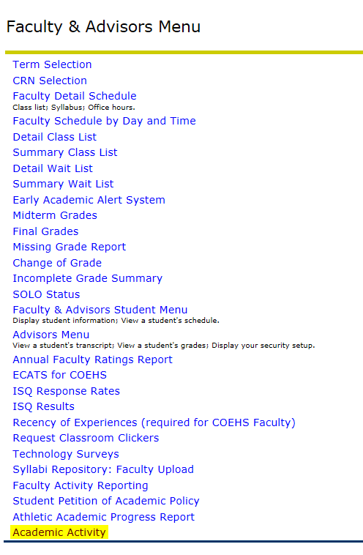
Academic Activity Tracking
From the Academic Activity screen:
Select the Term
Select the Part of Term
Select the Course
Click Submit (this will pull up a list the currently enrolled students for the CRN)

Slide 20
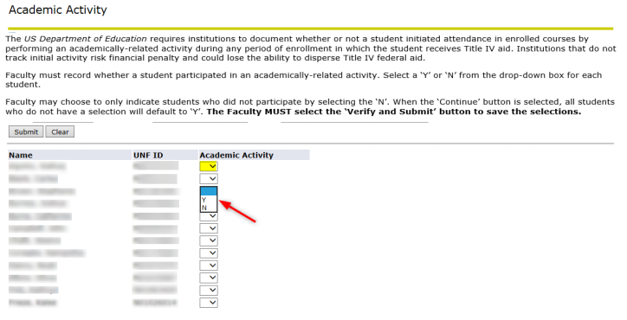
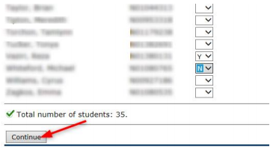
Academic Activity Tracking
Use the drop down button to select Y or N for each student in the course section.
Faculty may choose to only indicate students who did not participate by selecting the N and then select Continue to populate all the Y students at once.
Once Academic Activity has been recorded, scroll to the bottom and select Continue.

Slide 21
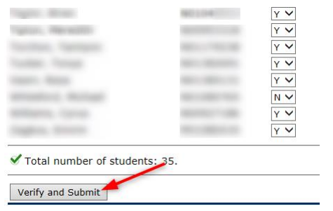
Academic Activity Tracking
After selecting Continue, a message will appear “The selections have not been saved. Select the Verify and Submit button to save.” All blank selections will change to Y. Once the selections have been reviewed, you must scroll to the bottom and select Verify and Submit.
NOTES:
All N selections will continue to show in a drop down button until the deadline.
N selections may be changed from N to Y until the deadline. Y selections may not be changed once submitted.
If all selections are Y, then no buttons are displayed.

Slide 22
Academic Activity Tracking
Deans and Chairs have access to an Academic Activity Report by Course which can be sorted and exported to Excel. Instructions for running this report can be found on our Faculty/Staff Resources page: https://www.unf.edu/onestop/registrar/Faculty_and_Staff_Resources.aspx
or by clicking here.
IMPORTANT: Students who late register, course transfer, and/or reinstate will need to have their academic activity tracked. Therefore, in some cases, an instructor who has already completed academic activity tracking for their course(s) will need to go back into the screen to complete tracking for the students who have had changes to their registration since the instructor first completed the process.

Slide 23
Course Withdrawal Limits
Degree-seeking and non-degree seeking undergraduate students (including post-bac) are limited to the following:
Three (3) withdrawals for 1000/2000 level courses
Three (3) withdrawals for 3000 level or higher courses
Medical withdrawals, withdrawals for military service, etc are excluded from withdrawal limit
WP and WF grades count in withdrawal total
Effective for courses taken Fall 2013 or later; courses taken Summer 2013 and earlier DO NOT count in the total
No withdrawal limit for graduate students

Slide 24
Withdrawal Screen (Student View)

Slide 25
Petitions and Forms
Late Registration (form)
Request for Course Transfer (form)
Grade Forgiveness (via self-service)
Term Forgiveness (via self-service)
Student Petition of Academic Policy* (via self-service):
Extend the Late Registration Deadline
Extend the Course Transfer Deadline
Withdrawal After the Deadline
Exceed the Undergraduate Course Withdrawal Limitation Policy
Graduate with Fewer than 120 Credit Hours
Graduate with Fewer than 48 Upper Level Credit Hours
Waive the BOG Summer Session Enrollment Requirement
*Levels of approval include Advisor, Instructor, and/or Chair

Slide 26
Academic Misconduct
Unforgivable F (Punitive F)
“FA” grade on transcript
Cannot use grade forgiveness
Transcript notation in certain cases

Slide 27
Grading
Grading deadline is the second business day after the end of the term – Tuesday – 10am
Grades not submitted by deadline are “NR”
Late grades are submitted via Change of Grade by instructor – sent to chair queue for final approval
Failing and Incomplete grades – Last Date of Attendance required
Missing grades

Slide 28
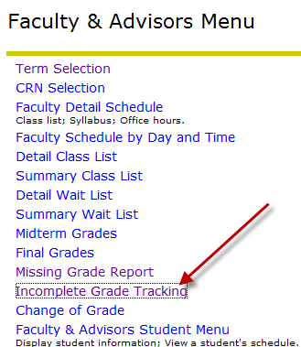
Grading
Faculty & Advisors’ Menu > Incomplete Grade Tracking
***Will NOT update final grade immediately – MUST submit Change of Grade***
Students are not allowed to re-register for a course in which an Incomplete grade currently stands. Once the Incomplete is resolved, the student can re-register.

Slide 29
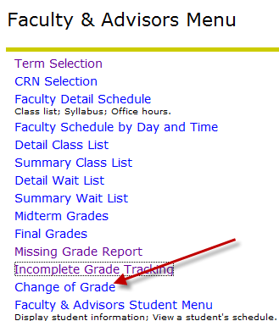
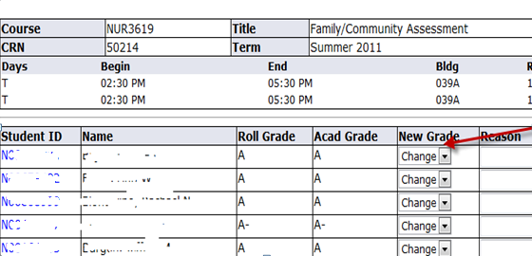
Grading
Faculty & Advisors Menu > Change of Grade
Choose Term and click Select
Click on CRN
Select new grade in drop down menu, enter Reason, and click on Update at bottom of screen

Slide 30
Grading
UNF Administrative Applications > Course Enrollment > Grade Change Review
Review and approve submitted grade changes – including Incompletes
Automatically updates Banner
Academic Standing will be updated the following week (if applicable)

Slide 31
Suspension Processing
Self-Service suspension decisions
Students dropped from future term
E-mail notification
Additional communication from advising units
Must sit out one semester before returning

Slide 32
Suspension Processing
UNF Administrative Applications > Student Information > Suspension Processing

Slide 33
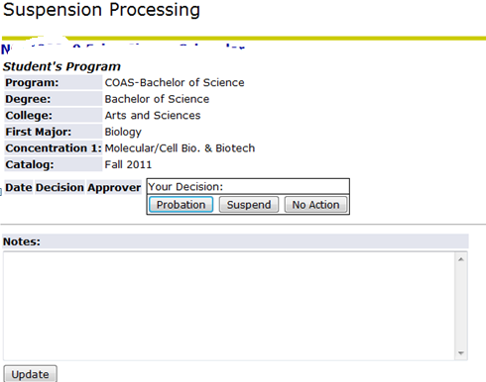
Suspension Processing
Click View to see:
Student’s program
Current term’s schedule
Future term’s schedule
GPA information
Prior academic standings

Slide 34
DIS Course Titles
May be submitted at any time during the semester
Student transcripts are updated with individual titles after semester has rolled to academic history
Contact University Scheduler for access

Slide 35
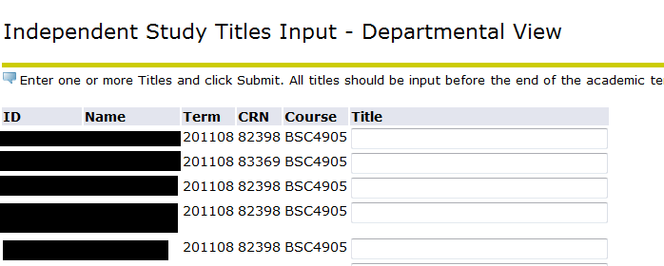
DIS Course Titles
UNF Administrative Applications > Student Maintenance > Independent Study Titles Input – Departmental View

Slide 36
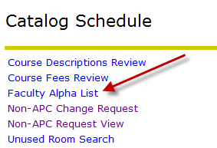
Faculty Alpha List (FAL)
UNF Administrative Applications > Catalog Schedule > Faculty Alpha List
Percentages of responsibility
cannot exceed 100%
Two week submission window in fall/spring – longer in summer due to multiple parts of term

Slide 37
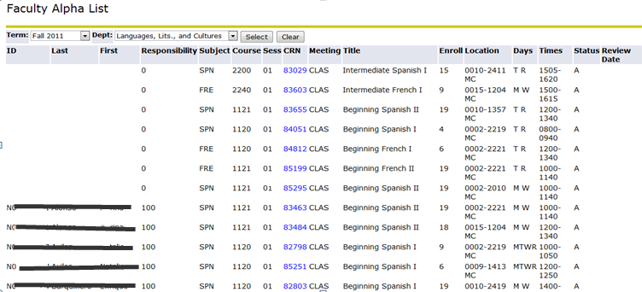
Faculty Alpha List (FAL)
Click CRN to enter instructor information

Slide 38
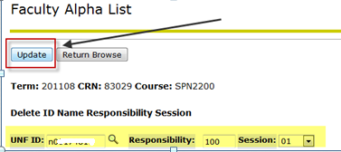
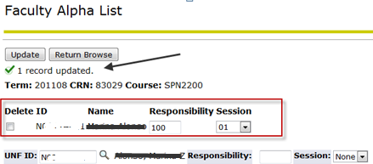
Faculty Alpha List (FAL)
Enter instructor N number, percentage of responsibility, and session - Click Update
Entry must equal 100% to be saved, so you will get an error message until all instructors are entered (if there are multiple instructors).

Slide 39
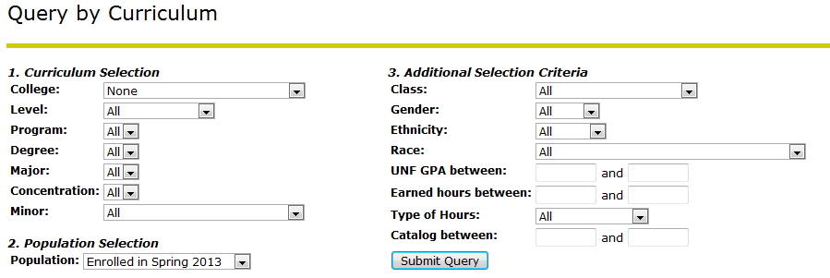
SIS Reports
UNF Administrative Applications > SIS Reports > Report by Curriculum
Data Requests sent to Records if not handled by this query; must sign Non-Disclosure form

Slide 40
FERPA
FERPA FAQs for Faculty: http://www.unf.edu/onestop/registrar/FERPA_-_Faculty.aspx
Confidentiality of student records is critical- particularly grades and UNF email addresses
Refer requests for student information to Registrar’s Office
Presentations can be given to departments or groups by Records staff, upon request

