Slide 1
Change of Grade
Use this form to change the final grade assigned to a student registered in any course in which you are an assigned instructor. This form will allow you to access any past course and will only allow updates to final grades.
Access the Change of Grade form found under the Faculty Services tab on the Faculty and Advisors Menu.

Slide 2
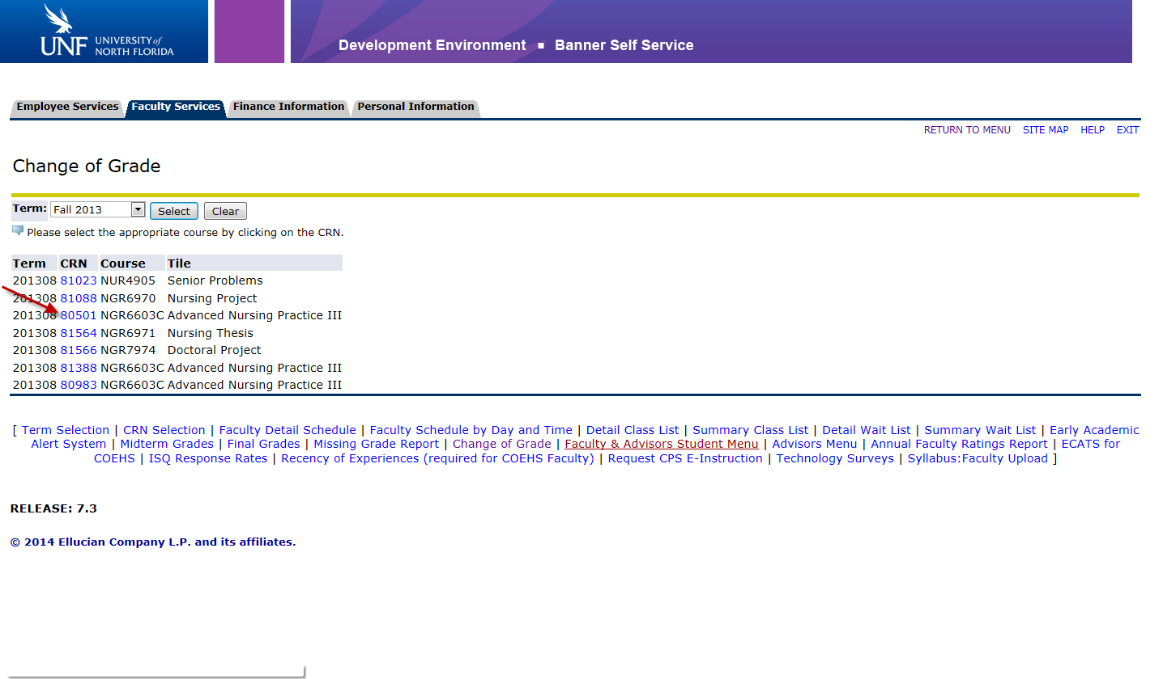
Select the term for the course you wish to view. If the student requiring the update completed the course in Fall 2013 then you will select “Fall 2013” in the drop down.
Once you select the term, all courses for which you are assigned as an instructor will appear. Select the appropriate CRN for the course you wish to review.

Slide 3
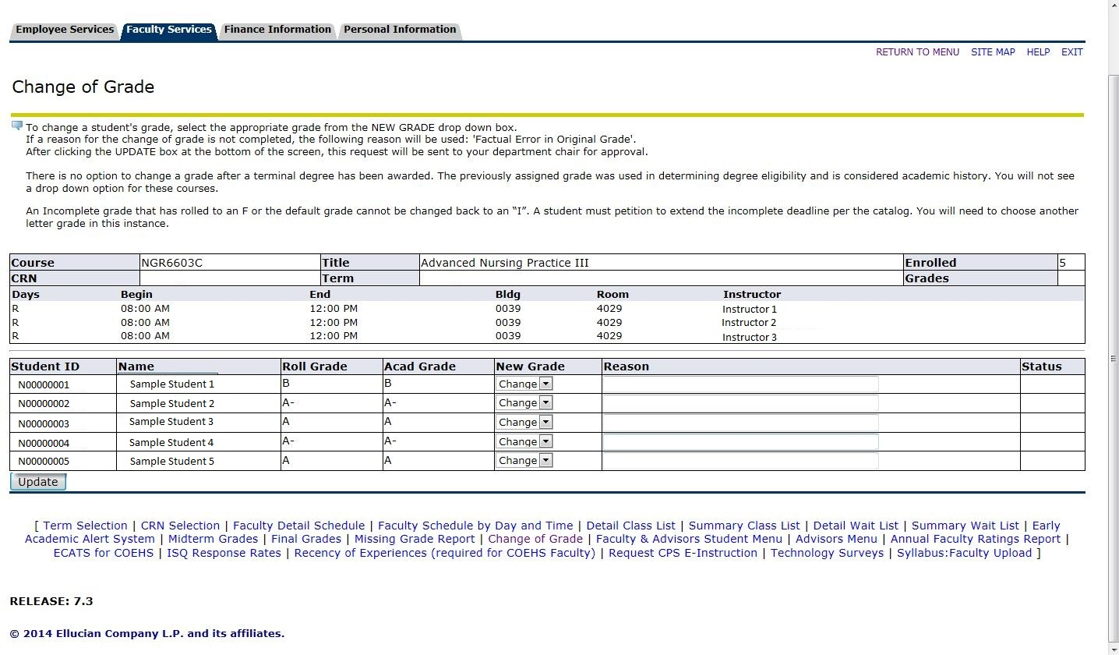
All students from the selected CRN will appear and you will see the “Roll Grade” which is the grade that rolled to academic history, the “Acad Grade” which is the grade previously assigned and the drop down for the “New Grade”.

Slide 4
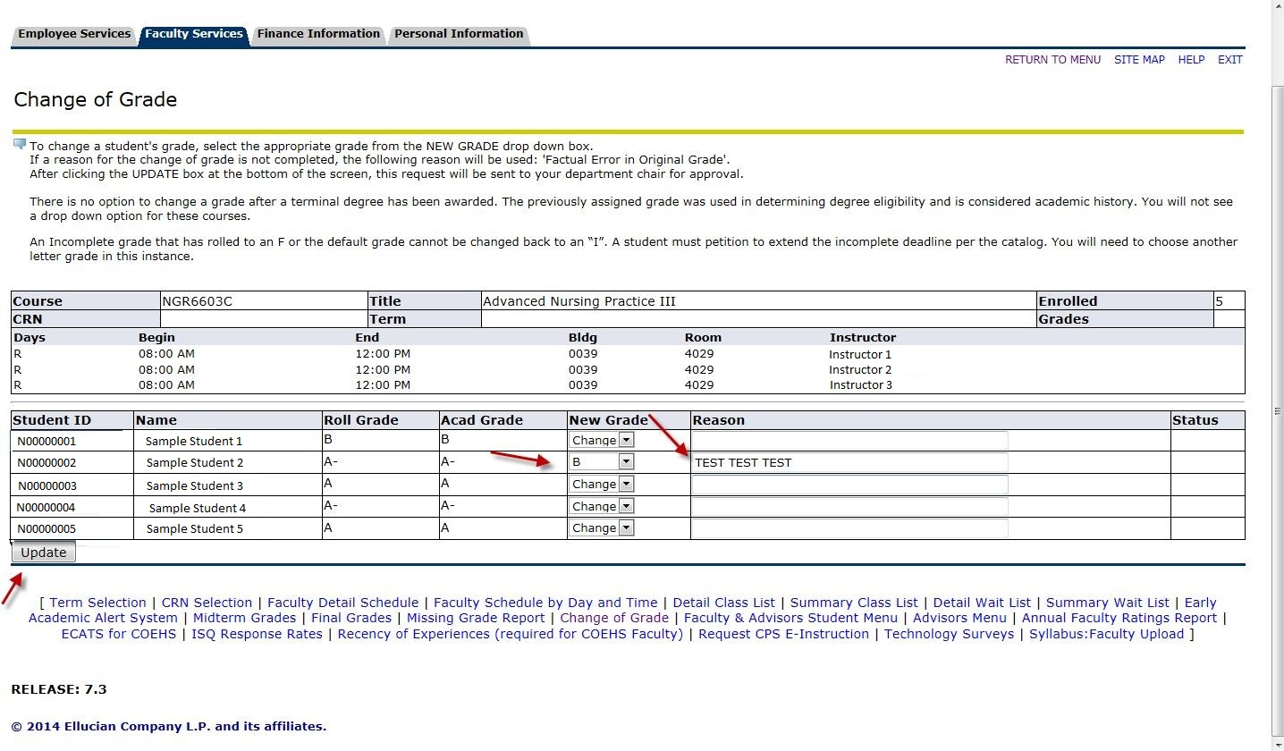
Select the new grade and indicate the reason for the change. Click Update once this process is complete.

Slide 5
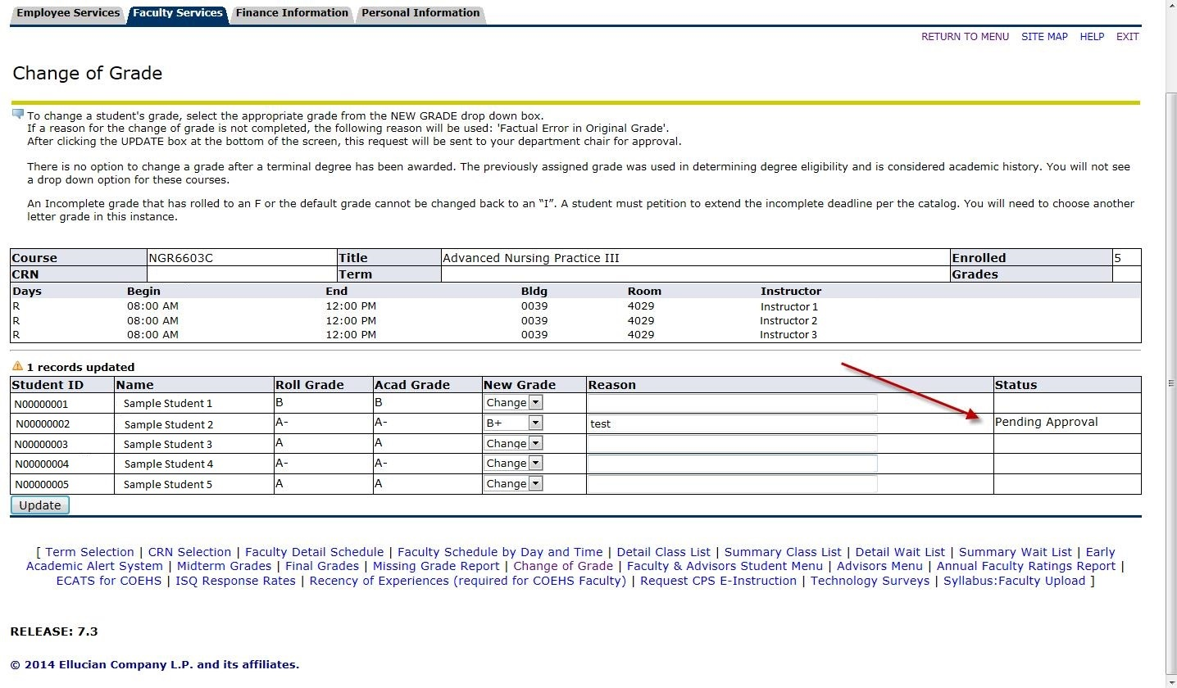
Submission will be confirmed by the “Pending Approval” notice found under status. The pending approval notice means that the request was forwarded to the assigned Department Chair for final approval and automatic updating.

