Slide 1
2020 TITLE IX REGULATIONS TRAINING REQUIREMENTS August 31, 2020
Presented by Kirsten Doolittle

Slide 2
Kirsten Lea Doolittle Admitted to the Florida Bar, 2004 Admitted to the D.C. & Virginia Bar, 2000 JD, Univ. of Southern California, 2000 BA, Dartmouth College, 1996
Certified investigator, decision maker and hearing officer
Practiced law for over 20 years
Board certified in labor and employment law
Florida Supreme Court Circuit Civil Mediator
Florida Supreme Court Qualified Arbitrator
Founder of Aequitas Counsel
Mom to two amazing middle schoolers
Spouse to a fabulous surf shop owner
Dedicated cross fitter and terrible surfer
Currently reading Untangled and Heavy
Pronouns: she, her and hers

Slide 3
AGENDA 9 – 10:30 Introductions Objective & Required Topics Legal Context Title IX Definitions Overview of Process 10:30 Break 10:45-12 Supportive Measures Initial Assessment Informal Resolution Overview of Formal Process Formal Complaint Jurisdiction Determinations 12-1:00 Lunch 1-2:15 Guiding Principles Investigations 2:15 Break 2:30-4:30 Investigations Hearings JEOPARDY!!!!!

Slide 4
Comply with Training Requirements
On May 6, 2020, the Department of Education released a 2033 page document that introduced material changes to the implementing regulations for Title IX, effective August 14, 2020.*
These regulations mandate that Title IX personnel receive training on specific topics covered by the 2020 Title IX Regulations.
The purpose of this training is to comply with that mandate.
*The original document that was sent to the Federal Register for publication was released on May 6, 2020. The official version was published on May 19, 2020. See Nondiscrimination on the Basis of Sex in Education Programs or Activities Receiving Federal Financial Assistance, 85 FR 30026 (May 19, 2020). References to “p. xxxx” refers to the original document that was released on May 6, 2020, and that can be found at
https://www2.ed.gov/about/offices/list/ocr/docs/titleix-regs-unofficial.pdf; p. 825, n. 1034
Quiz 1: Who are “Title IX personnel”?

Slide 5
REQUIRED TRAINING TOPICS
Title IX’s definition of “sexual harassment”
The scope of the school’s education program or activity
How to conduct an investigation and grievance process
How to serve impartially & avoid prejudgment of the facts
How to avoid conflicts of interest and bias
Evaluating relevance of evidence
Understanding what evidence must be excluded
Preparing an investigative report that fairly summarizes evidence
Informal resolution
Office for Civil Rights Blog - 20200518; 34 CFR § 106.45(b) (1)(iii) & § 106.45(b)(10)(i)(D); This blog post can be found at:
https://www2.ed.gov/about/offices/list/ocr/blog/20200518.html?utm_content=&utm_medium=email&utm_name=&utm_source=govdelivery&utm_term

Slide 6
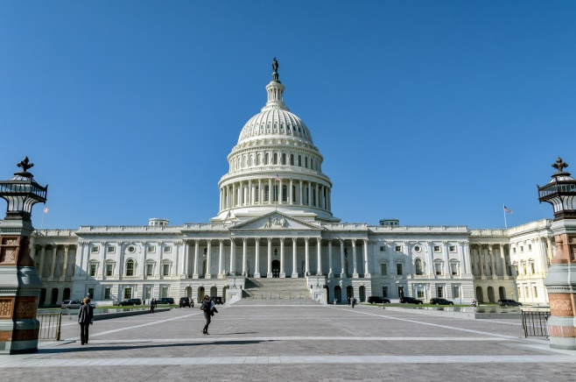
LEGAL CONTEXT
TITLE IX
No person in the United States shall, on the basis of sex, be excluded from participation in, be denied the benefits of, or be subjected to discrimination under any education program or activity receiving Federal financial assistance.
TITLE IX of the Education Amendments of 1972, 20 U.S.C. § 1681
37 words passed in 1972
Long thought to apply only to athletics
First used to address faculty inequity
Required to follow because of federal financial assistance, also CARES Act

Slide 7
LEGAL CONTEXT 2020 TITLE IX REGULATIONS
FOCUS ON COMPLIANCE:
“[The’ final regulations represent the Department’s interpretation of a recipient’s legally binding obligations, rather than best practices, recommendations, or guidance . . . [and] focus on precise legal compliance requirements governing recipients.”
p. 18 (emphasis added)
MATERIAL CHANGES:
Complaint process
Jurisdiction limitations
Investigation requirements
Live hearings
Relevancy determinations
Required cross examination by advisors

Slide 8
TITLE IX’S DEFINITION OF SEXUAL HARASSMENT
Quid Pro Quo Sexual Harassment
Severe and Pervasive Sexual Harassment
Rape*
Sodomy
Sexual Assault with an Object
Fondling
Incest
Statutory Rape
Dating Violence
Domestic Violence
Stalking
* Section 106.30 (defining “sexual harassment” to include sexual assault, dating violence, domestic violence or stalking as defined in the Clery Act and VAWA statutes). See 34 U.S.C. § 12291 (a)(29) (May 29, 2020); 79 Fed. Reg. 62, 752 (2013 reauthorization of VAWA amending section 485(f) of the Clery Act).

Slide 9
But first…….. A word about names and hypotheticals

Slide 10
QUID PRO QUO SEXUAL HARASSMENT
an employee of the University,
conditions the provision of an aid, benefit, or service of the University,*
on an individual’s participation in unwelcome sexual conduct.**
* Implicitly or explicitly.
** Unwelcomeness is subjective and determined by the complainant.
Hypo: Justin is Mia’s Calculus Professor
Justin: Your grade could improve if you spent more time on the class.
Mia: I really need a better grade to stay on the team. I am attending all of the tutorial sessions and classes. And I have a study group. What else can I do?
Justin: Why don’t you come to dinner with me and we can talk about some options to improve your grade?
Quiz 2: Is this sexual harassment?

Slide 11
SEVERE & PERVASIVE SEXUAL HARASSMENT
unwelcome conduct,
determined by a reasonable person,
to be so severe, and
pervasive, and
objectively offensive,*
that it effectively denies a person equal access to the school’s/district’s education program or activity.
* Severity, pervasiveness, and objective offensiveness are evaluated based on the totality of the circumstances from the perspective of a reasonable person in the same or similar circumstances including the context in which the alleged incident occurred, and any similar, previous patterns.
Hypo: Bobby is a third-year student who participates in the Spanish club with Annie who is a first-year student.
Bobby repeatedly sends graphic, sexually-oriented jokes and pictures around campus via social media to hundreds of other students. Many students don’t find it funny and ask Bobby to stop, but he does not. Because of these jokes, Annie avoids Bobby on campus and stops going to Spanish club, eventually dropping the club all together.
Quiz 3: Does this constitute sexual harassment?

Slide 12
SEXUAL OFFENSES
Rape
penetration,
no matter how slight,
of the vagina or anus with any body part or object, or
oral penetration by a sex organ of another person,
without the consent of the complainant.
Sodomy
oral or anal sexual intercourse with another person,
forcibly,
and/or against that person’s will (non-consensually), or
not forcibly or against the person’s will in instances in which the complainant is incapable of giving consent because of age or because of temporary or permanent mental or physical incapacity.
Sexual Assault with an Object
the use of an object or instrument to penetrate,
however slightly,
the genital or anal opening of the body of another person,
forcibly,
and/or against that person’s will (non-consensually),
or not forcibly or against the person’s will in instances in which the complainant is incapable of giving consent because of age or because of temporary or permanent mental or physical incapacity.
Hypo:
Min is a junior. Rebecca is a sophomore. Min comes to Rebecca ’s dorm with mutual friends to watch a movie. Min and Rebecca, who have never met, are attracted to each other. After the movie, everyone leaves, and Min and Rebecca are alone. They hit it off, become more intimate, and begin kissing one another. Min verbally expresses his desire to have sex with Rebecca. Rebecca, who was abused by a babysitter at the age of five and avoids sexual relations as a result, is shocked at how quickly things are progressing. As Min takes her by the wrist over to the bed, lays her down, undresses Rebecca, and begins to have vaginal intercourse with her, Rebecca has a severe flashback to her childhood trauma. She wants to tell Min to stop but cannot. Rebecca is stiff and unresponsive during intercourse.
Quiz 4: Does this constitute a sexual offense ?

Slide 13
How do the regulations define consent?
They do not.
“The Department believes that the definition of what constitutes consent for purposes of sexual assault within a recipient’s educational community is a matter best left to the discretion of recipients, many of whom are under State law requirements to apply particular definitions of consent for purposes of campus sexual misconduct policies.”
p. 363

Slide 14
FONDLING, INCEST & STATUATORY RAPE
FONDLING
the touching of the private body parts of another person,
for the purpose of sexual gratification,
forcibly,
and/or against that person’s will (non-consensually), or not forcibly or against the person’s will in instances in which the complainant is incapable of giving consent because of age or because of temporary or permanent mental or physical incapacity.
Incest
non-forcible sexual intercourse,
between persons who are related to each other,
within the degrees wherein marriage is prohibited by Florida law.
Statutory Rape
non-forcible sexual intercourse,
with a person who is under the statutory age of consent of 18.
Hypo:
Marcus and Wendy are first year students and play on the school’s men and women’s soccer teams. The teams often travel together to away games. After an evening game in Tampa, the teams load onto the bus to head home. Marcus asks to sit next to Wendy and they talk about their games and how they both played. Its late and Wendy nods off. Wendy wakes up and feels Marcus’ hand on her inner, upper thigh. She quickly removes his hand and moves to another seat.
Quiz 5: Does this constitute fondling?

Slide 15
DATING VIOLENCE & DOMESTIC VIOLENCE
DATING VIOLENCE
violence
on the basis of sex
committed by a person who is in or has been in a social relationship of a romantic or intimate nature with the complainant.
The existence of such a relationship shall be determined based on the complainant’s statement and with consideration of the length of the relationship, the type of relationship, and the frequency of interaction between the persons involved in the relationship. For the purposes of this definition—
Dating violence includes, but is not limited to, sexual or physical abuse or the threat of such abuse.
Dating violence does not include acts covered under the definition of domestic violence.
DOMESTIC VIOLENCE
violence
on the basis of sex
committed by
a current or former spouse or intimate partner of the complainant,
a person with whom the Complainant shares a child in common,
a person who is cohabitating with, or has cohabitated with, the complainant as a spouse or intimate partner, or
a person similarly situated to a spouse of the complainant under the domestic or family violence laws of Florida, or
any other person against an adult or youth complainant who is protected from that person’s acts under the domestic or family violence laws of Florida.
Hypo:
Terrance and Sam have been hanging out for about 3 weeks. They have hooked up twice in that time, during which they kissed and touched one another’s genitals (consensually). After their second hook up, Terrance decides that Sam is too needy and breaks its off.
Six weeks later, Terrance is at a small party and sees Sam. Sam gives Terrance the cold shoulder. They both have a few beers with friends and Terrance asks Sam if he wants to walk back to his dorm room. Sam agrees. On the walk, they get into an argument about their break-up.
Terrance calls Sam a needy idiot, Sam punches Terrance in the stomach and walks away, leaving Terrance on the ground, gasping for air.
Quiz 6: Does this constitute dating or domestic violence?

Slide 16
STALKING
STALKING
engaging in a course of conduct,
on the basis of sex,
directed at a specific person, that
would cause a reasonable person to fear for the person’s safety, or
the safety of others; or
suffer substantial emotional distress.
For the purposes of this definition –
Course of conduct means two or more acts, including, but not limited to,
acts in which the respondent directly, indirectly, or through third parties, by any action, method, device, or means, follows, monitors, observes, surveils, threatens, or communicates to or about a person, or interferes with a person’s property.
Reasonable person means a reasonable person under similar circumstances and with similar identities to the complainant.
Substantial emotional distress means significant mental suffering or anguish that may but does not necessarily require medical or other professional treatment or counseling.
Hypo:
Erin and Dominique were friends with benefits. Dominique wanted a more serious relationship, which caused Erin to break it off. Dominique could not move on and texted Erin every morning and evening asking her to come back. Erin obtained a no-contact order. Subsequently, Erin discovered that their Insta account was being accessed, with postings as if they were from Erin, but they were not.
Whoever accessed their Insta account posted a picture of a woman’s breasts, making it look as if Erin had posted a picture of themself, which was not the case. This caused Erin considerable embarrassment and social anxiety.
They changed their passwords, only to have it happen again. Seeking help from the Title IX Coordinator, Erin met with the IT department, which discovered an app on their phone, which was being used to transmit their data to a third party.
Quiz 7: Does this constitute stalking?

Slide 17
Overview of Process
Overview of Process Text Outline
The flowchart begins with Report of Sexual Misconduct Received
Supportive Measures (items a and b are two alternate paths after item 2.)
Allegations Include Title IX Sexual Harassment (items I and II are two alternate paths after item a)
I. No Formal Complaint (items Ia and Ib are two alternate options after item I)
Ia. Title IX Coordinator Agrees Supportive Measures Only
Ib. Title IX Coordinator Signs Formal Complaint
II. Formal Complaint (items IIa, IIb, IIc, IId and IIe are five alternate options after item II)
IIa. Dismissal of Formal Complaint if conduct does not meet definition and/or jurisdiction of Title IX Sexual Harassment
IIb. Notice of Investigation & Allegations (items II, IIa, and IIb lead to item b. Dismissal of formal complaint of conduct does not meet definition and/or jurisdiction of Title IX Sexual harassment)
IIc. Investigation
IId. Live Hearing
IIe. Notice of Outcome & Appeal
b. Dismissal of formal complaint of conduct does not meet definition and/or jurisdiction of Title IX Sexual harassment (item b leads to item c)
c. Allegations Do Not Include Title IX Sexual Harassment (items III, IV, and IV are three alternate paths after item c)
III. Allegations include violations under Sexual Misconduct Policy (proceed to IIIa)
IIIa. Investigation conducted by EOI (proceed to IIIb)
IIIb. EOI finds reasonable cause (items IIIb.1 and IIIb.2 are two alternate paths after item IIIb)
IIIb.1 Student Respondents: Student Conduct process
IIIb.2 Employee Respondents: Human Resources process
IV. Allegations include violations under Student Code of Conduct (proceed to IVa)
IVa. Student Conduct Process
V. Allegations include violations of employee policies (proceed to Va)
Va. Human Resources Process
Informal Resolution can occur at any time following Formal Complaint and before a finding of responsibility
If EOI, Student Conduct or Human Resources determines that allegations meet the definition of Title IX Sexual Harassment, process must return to Formal Grievance Process.

Slide 18
BREAK
You made it! A couple of things:
Don’t forget to mute yourself on break.
Feel free to post comments or questions publically or privately in the chat. I will try and answer them before we start back.
If there are technical problems, please let me know so we can fix them.
Be right back!

Slide 19
OFFER SUPPORTIVE MEASURES
What are supportive measures?
Supportive measures are non-disciplinary, non-punitive individualized services offered as appropriate, as reasonably available, and without fee or charge to the parties to restore or preserve access to the school’s education program or activity, including measures designed to protect the safety of all parties, and/or deter harassment, discrimination, and/or retaliation.
Upon receive of complaint:
TIX Coordinator promptly contacts complainant
Discusses supportive measures
Considers complainant’s wishes
Explains the option of filing a formal complaint.
34 CFR § 106.30; 34 CFR § 106.44(a)
Prompt
Non-disciplinary
Restore or preserve access

Slide 20
EXAMPLES OF SUPPORTIVE MEASURES Quiz 8: Can a student athlete be removed from a sports team as a supportive measure? p. 570-71
Referral to counseling, medical, and/or healthcare services
Referral to Employee Assistance Program
Referral to community-based service providers
Visa and immigration assistance
Student financial aid counseling
Education to the community or community subgroup(s)
Altering work arrangements
Safety planning
Implementing contact limitations between the parties
Academic support, extensions of deadlines, course adjustments
Class schedule modifications, withdrawals, or leaves of absence
Any other actions deemed appropriate by the TIX Coordinator

Slide 21
MAKE INITIAL ASSESSMENT
Supportive Measures
privacy
prompt
restorative
Informal Resolution
party driven
less adversarial
not all contexts
Formal Grievance Process
notice & process
more adversarial
more information
Supportive Measures
Informal Resolution
Formal Grievance Process

Slide 22
WHAT IS INFORMAL RESOLUTION?
“Informal resolution may encompass a broad range of conflict resolution strategies, including, but not limited to, arbitration, mediation, or restorative justice. Defining this concept may have the unintended effect of limiting parties’ freedom to choose the resolution option that is best for them, and recipient flexibility to craft resolution processes that serve the unique educational needs of their communities.”
34 CFR § 106.45(b)(9); p. 1370
Factors to Consider:
Parties preference
Likelihood of resolution
Civility of the parties
Violence risk assessment
Skill of facilitator with issues
Capacity of the parties
Goals of the parties

Slide 23
INFORMAL RESOLUTION REQUIREMENTS
Must file a formal complaint
Written notice of allegations, requirements of informal resolution process, and consequences of informal resolution process must be issued before informal resolution
Both parties must provide written consent to participate
TIX Coordinator must approve mechanism
May not be used in student complainant/employee respondent
Resolution must be agreed upon by the parties and approved by TIX Coordinator
Resolutions are not appealable and may include a confidentiality component
May begin informal resolution any time after formal complaint and before written determination
May withdraw and resume formal grievance process any time
Facilitators must be well trained, free from bias and conflict of interest
30-45 day time frame is reasonable
34 CFR §§ 106.45(b)(1)(iii); 106.45(b)(9)(i)

Slide 24
Overview Formal Grievance Process
Formal Complaint
Review for sufficiency
Appointment of investigator
Notice of investigation and allegations 106.45(b)(2)(ii)-(iii)
Review and evidence “directly related to the allegations” 106.45(b)(2)(ii)-(iii)
Notice of interview to party and advisor 104.55(b)(x)(x)
Interview parties and witnesses
Send any evidence “directly related to the allegations to each party and advisor” 106.45(b)(5)(vi) (there is a 10 day review before the process proceeds to item 9)
Create investigation report that fairly summarizes relevant evidence
Consider parties response from review of evidence
Send investigation report to each party and advisor, at least 10 days prior to a hearing 106.45(b)(5)(vii) (there is a 10 day review before the process proceeds to item 12)
Finalize report, including consideration of any necessary changes based on parties’ feedback
Send investigative report to Title IX Coordinator to review for completeness
Send investigative report to parties and advisors
Schedule live hearing

Slide 25
WHAT IS A FORMAL COMPLAINT ?
WHO MAY FILE?
Complainant
participating in, or attempting to participate in, the school’s education program or activity
TIX Coordinator
with or without the complainant’s desire to participate
Whether conduct meets definition of sexual harassment
Conditions necessitating a response to those allegations to prevent “deliberate indifference”
Threat assessment
Allegation against faculty
Parent or Guardian
If has the legal right to act on the complainant’s behalf
A formal complaint “means a document filed by the complainant or signed by the TIX Coordinator alleging sexual harassment against a respondent and requesting that the recipient investigate the allegation of sexual harassment.”
Email, online portal
Digital or physical signature
Quiz 9: Can a student athlete recruit file a formal complaint?
34 CFR §§ 106.30; 34 CFR §106.6(g); p. 383, n. 571

Slide 26
ASSESS FORMAL COMPLAINT FOR SUFFICIENCY
Mandatory Dismissal.
Schools must dismiss a formal complaint if the conduct alleged:
Would not constitute sexual harassment even if proved; and/or
Did not occur in the University’s education program or activity; and/or
Did not occur against a person in the United States.
34 CFR § 106.45(b)(3)(i)

Slide 27
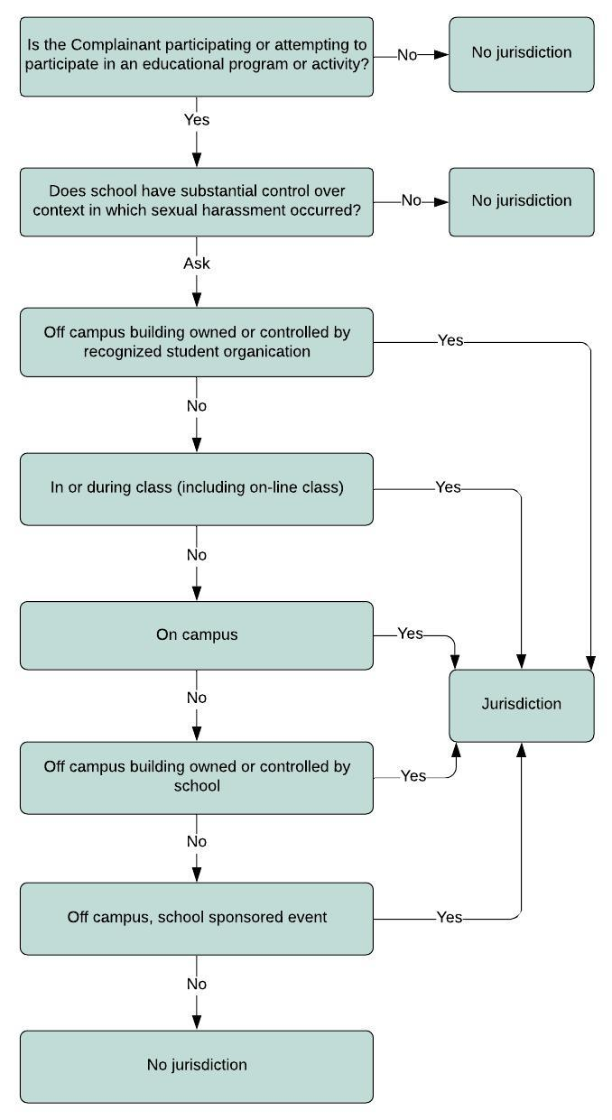
EDUCATION PROGRAM OR ACTIVITY
EDUCATION PROGRAM OR ACTIVITY
1. Top of chart begins Q: Is the Complainant participating or attempting to participate in an educational program or activity?
A. If “No” No jurisdiction
2. If “Yes” then Q: “Does school have substantial over context in which sexual harassment occurred?
A. If “No” No jurisdiction
3. If “Yes” then Q: Off campus building owned or controlled by recognized student organization
A. If “Yes” Jurisdiction
4. If “No” In or during class (including on-line class)
A. If “Yes” Jurisdiction
5. If “No” On Campus
A. If “Yes” Jurisdiction
6. If “No” Off campus building owned or controlled by school
A. If “Yes” Jurisdiction
7. If “No” Off campus, school sponsored event
A. If “Yes” Jurisdiction
8. If “No” No jurisdiction
Preamble mentions several factors to consider:
ownership of the premises
endorsement
oversight
supervision
disciplinary power
34 CFR § 106

Slide 28
EDUCATION PROGRAM OR ACTIVITY?
EDUCATION PROGRAM OR ACTIVITY
EPA?
Sexual assault occurs in a hotel room by a student athlete against a student athlete travelling to an away game.
EPA?
Sexual assault by student against student at an off-campus party.
EPA?
Student from another school stalking student, by following student around campus and sending sexually graphic emails to student’s school email account.
EPA?
Faculty member sending unwelcome, sexually graphic text messages to department administrator’s cell phone.
EPA?
University contractor employee harassing student employees working on campus.
Preamble mentions several factors to consider:
ownership of the premises
endorsement
oversight
supervision
disciplinary power
34 CFR § 106

Slide 29
GROUNDS FOR PERMISSIVE DISMISSAL
Permissive Dismissal:
Schools may dismiss a formal complaint in the following circumstances:
Complainant notifies the TIX Coordinator in writing that the complainant would like to withdraw the Formal Complaint or any allegations therein;
The respondent is no longer enrolled or employed by the school; or
Specific circumstances prevent the school from gathering evidence sufficient to reach a determination as to the formal complaint or allegations therein.
The TIX Coordinator will evaluate whether dismissal would be clearly unreasonable in light of the known circumstances.
34 CFR § 106.45(b)(3)(ii)-(iii)

Slide 30
Pro Tip: Investigate As If You Will Be Investigated.

Slide 31
GUIDING PRINCIPLES OF INVESTIGATIONS
Treat parties equally
Objectively evaluate all relevant evidence
Maintain impartiality and eliminate bias and conflict
Keep burden of gathering evidence on the school
Keep burden of proof (of violations) on the school
Maintain presumption that R is not responsible
Give equal opportunity to present & review evidence
Adhere to reasonably prompt time frames
34 CFR 106.45(b)(5)(i); 34 CFR 106.45(b)(1)(iv); p. 1123

Slide 32
EQUAL NOTICE & EQUAL OPPORTUNITY
Keep parties informed at every step
simultaneous communication
same comment
Provide equal opportunity
to present fact and expert witnesses
to review evidence
to respond to evidence
to appeal

Slide 33
OBJECTIVE EVALUATION OF THE EVIDENCE
Review evidence “directly related to the allegations” including evidence on which the school does not intend to rely in reaching a determination
Review exculpatory and inculpatory evidence whether obtained from a party or other source
Regulations do not define relevance: “these terms should be interpreted using their plain and ordinary meaning.”
Ask: Does the evidence tend to make the allegation more or less true?
34 CFR 106.45(b)(5)(ii); 34 CFR 106.45(b)(5)(vi); p. 1017

Slide 34
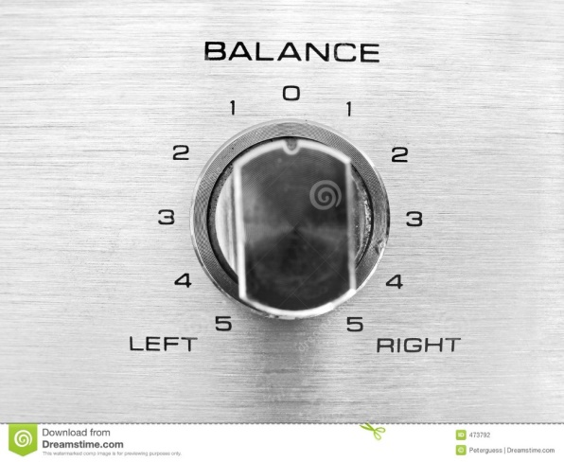
IMPARTIALITY, AVOIDING CONFLICTS OF INTEREST & BIAS
Impartiality
Tone
Notices
Flexibility
Requests
Evidence collection
Rescheduling
Inferences
Conversation
Conflicts
Appearance
Prior cases
Relationships
Reporting structures
Prejudgment
Bias
Confirmation
Conclusion
Priming
Implicit
https://implicit.harvard.edu/implicit/aboutus.html

Slide 35
Bias
“Specifically, implicit bias refers to attitudes or stereotypes that affect our understanding, actions, and decisions in an unconscious way, making them difficult to control.”
(Greenwald & Banaji, 1995)
https://implicit.harvard.edu/implicit/aboutus.html
Does this person remind you of yourself?
Does this person remind you of someone you know?
Are there things about this person that influence your impression?
What assessments have you already made about the person?

Slide 36
TECHNICAL REQUIREMENTS OF INVESTIGATIONS
Notice of Investigation and Allegations
Recognizing Advisors
Planning and noticing interviews
Evidence that may not be obtained or relied upon
Restrictions on use of certain evidence
Conducting interviews
Reviewing evidence
Drafting the report
Reviewing the report

Slide 37
ASSIGNMENT OF INVESTIGATOR & NOTICE OF INVESTIGATION AND ALLEGATIONS
A meaningful summary of all of allegations The identity of the parties (if known) The precise misconduct alleged The date and location of the alleged incident(s) (if known) The specific policies implicated A description of applicable procedures A statement of the potential sanctions/responsive actions A statement that the school presumes the respondent is not responsible for the reported misconduct unless and until the evidence supports a different determination A statement that determinations of responsibility are made at the conclusion of the process and that the parties will be given an opportunity to inspect and review all directly related and/or relevant evidence obtained during the review and comment period A statement about the school’s policy on retaliation | Information about the privacy of the process Information on the need for each party to have an advisor of their choosing and suggestions for ways to identify an advisor A statement informing the parties that the school’s policy prohibits knowingly making false statements, including knowingly submitting false information during the resolution process Detail on how the party may request disability accommodations during the resolution process The name(s) of the investigator(s), along with a process to identify, in advance of the interview process, to the TIX Coordinator any conflict of interest that the investigator(s) may have An instruction to preserve any evidence that is directly related to the allegations 34 CFR § 106.45(b)(2)(ii)-(iii)
Opportunity to introduce investigator
Set up initial interview
Form document
Advisor policy
Statement of rights

Slide 38
WHO CAN BE A PARTY ADVISOR?
Schools must provide all parties with the same opportunities to have advisors present in Title IX proceedings and to have them participate, subject to equal restrictions on participation, at the school’s discretion.
Who can be an advisor? party’s choice
May be an attorney (but not required)
May be friends, family members or trusted individuals
May be union advisors
May be a witness in the hearing
34 CFR 106.45(b)(5)(iv); 34 CFR 106.45(b)(5)(vii); p. 994, 999

Slide 39
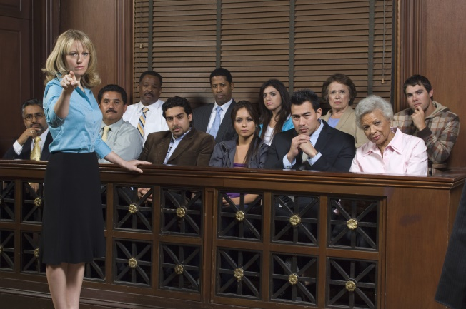
PARTICIPATION OF ADVISORS
Schools may require advisors not to disclose information outside the grievance process
Schools must permit a party’s advisor to conduct cross-examination on behalf of the party (later)
Schools may require parties to make opening or closing statements
“[T]he final regulations do not require training for advisors of choice.”
34 CFR 106.45(b)(5)(iv); 34 CFR 106.45(b)(5)(vii); p. 997, 1123

Slide 40
PLANNING INTERVIEWS
Complainant
Witnesses identified by the complainant
Witnesses with whom the complainant discussed allegations
Respondent
Witnesses identified by the respondent
Witnesses with whom the respondent discussed allegations
Follow up with complainant
Follow up with respondent

Slide 41
NOTICE REQUIREMENTS FOR INTERVIEWS
Written notice
Date, time and nature of interview (meetings and hearing)
Time to prepare for interview
May also convey notice in person or by telephone
Note: Do not have to copy notice of interview to advisors. OCR stated that this flexibility is “to preserve a [school’s] discretion to limit the participation of party advisors, and to preserve a party’s right to decide whether or not, for what purposes, and at what times, the party wishes for an advisor of choice to participate with the party.”
34 CFR 106.45(b)(5)(v); p. 1005

Slide 42
OPENING THE INTERVIEW
Establish rapport
Introduce yourself
My name is Kirsten Doolittle. I have been practicing primarily labor and employment law for 20 years. For the last five years, I’ve also worked as a Title IX investigator and hearing officer.
Promote transparency
Explain your role and process
Your school has hired me to conduct an independent investigation into the complaint by Susie.
I will be conducting interviews, gathering evidence and writing a report that summarizes that evidence for the school.
Develop trust
Identify school and Title IX’s anti-retaliation protections and your goal of providing an unbiased investigation.
My priority is to make sure that both parties feel they got a fair shake from me. I have no interest in the outcome other than that the process is fair.
Quiz 9: Can you prohibit interviewees from discussing their interview with others?

Slide 43
ASKING QUESTIONS
Beginning:
How do you know Michael?
What was the plan for that day/evening?
Tell me what happened.
Cover the 5 “Ws”: Who, what, when, where, why
Open ended: Can you tell me more about that?
Clarity on timelines/who is involved etc.
Did you “pregame” with Ann at her house before or after Michael joined the two of you?
Who else was there?
What do you mean by the phrase “hooking up?”
Closing questions
Is there anything else that you want to tell me?
Is there anything you thought I would ask, important for me to know, others I should talk with and why
Anything else? Anything else? Anything else?
End: Additional information, review statement, follow up questions.

Slide 44
EXCLUSION OF PRIOR SEXUAL BEHAVIOR & MEDICAL RECORDS
Prior Sexual Behavior:
Complainant's sexual predisposition or prior sexual behavior may not be offered unless they are offered to prove:
that someone other than the respondent committed the sexual harassment, or
if the questions and evidence concern specific incidents of the complainant's prior sexual behavior with the respondent and are offered to prove consent.
Medical Information:
Cannot use any party’s medical records without obtaining written consent to do so for use in the grievance process.
34 CFR 106.45(b)(6)(i)-(ii); (P. 2022-23)
HYPO:
Ann alleged that Michael sexually assaulted her at an on-campus party after she blacked out from drinking alcohol. Michael states that he did not have sex with Ann and that he was saw Ann walk into a bedroom with Frank. Michael also states that Ann has sex with people at parties almost every weekend after she has been drinking.
Does Michael’s comment about Frank come in?
Does Michael’s comment about Ann having sex every weekend come in?

Slide 45
PROVIDE PARTIES 10 DAYS TO REVIEW EVIDENCE Quiz 10: How do you ensure that you send over everything “directly related to the allegations” that you have received during the investigation?
Send parties and advisors by electronic copy or hard copy (with an NDA)
All evidence “directly related to the allegations” that is considered and provide feedback
Must include “inculpatory or exculpatory evidence whether obtained from a party or other source.”
Includes evidence that investigator is not relying upon
With a 10-day review period
May continue interviews and drafting report during this time
May not complete report until expiration of 10-day period
34 CFR 106.45(b)(5)(vi)

Slide 46
INVESTIGATION REPORT Quiz 11: Are there any findings in the investigation report?
Brief introduction of parties and nature of the complaint
Timeline of investigation
Initial complaint
Formal complaint
Appointment of investigator
Notice of Investigation and Allegations
Interviews conducted and evidence gathered
Site visits
First 10-day review of evidence by parties
Draft investigation report provided to parties
Second 10-day review and comment period by parties
Submission of investigation report to TIX Coordinator
Any delays (i.e., spring break, exam period) and notice provided
School policy provisions
Statement of jurisdiction
Timeline of allegations
Information from parties and witnesses
Information not included or witnesses not interviewed (and why)
“Summary of relevant evidence” (only requirement in regs)
34 CFR 106.45(b)(5)(vii)

Slide 47
BREAK TIME
Hang in there!
We are almost done.
10 slides to go.
There is still time to win a prize.

Slide 48
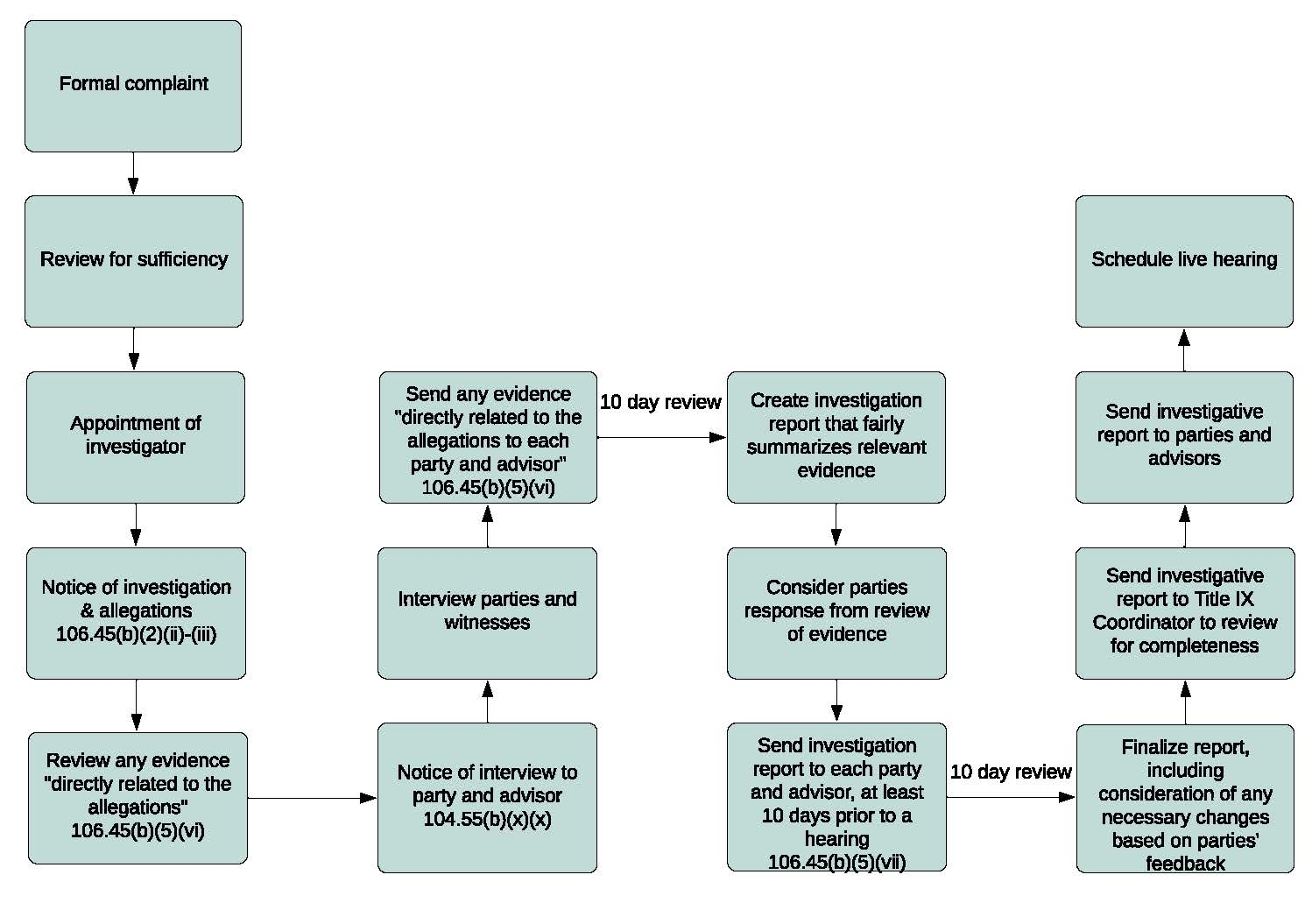
WHERE ARE WE?
Overview Formal Grievance Process Outline
Formal Complaint
Review for sufficiency
Appointment of investigator
Notice of investigation and allegations 106.45(b)(2)(ii)-(iii)
Review and evidence “directly related to the allegations” 106.45(b)(2)(ii)-(iii)
Notice of interview to party and advisor 104.55(b)(x)(x)
Interview parties and witnesses
Send any evidence “directly related to the allegations to each party and advisor” 106.45(b)(5)(vi) (there is a 10 day review before the process proceeds to item 9)
Create investigation report that fairly summarizes relevant evidence
Consider parties response from review of evidence
Send investigation report to each party and advisor, at least 10 days prior to a hearing 106.45(b)(5)(vii) (there is a 10 day review before the process proceeds to item 12)
Finalize report, including consideration of any necessary changes based on parties’ feedback
Send investigative report to Title IX Coordinator to review for completeness
Send investigative report to parties and advisors
Schedule live hearing
Question mark signaling what is next.
?

Slide 49
Live Hearings: What it’s NOT like.

Slide 50
LIVE HEARINGS
Must have a decision maker
Must provide advisors to the parties at hearing
Advisors must be willing to cross examine
Hearings must be live; virtual is allowed
At any party’s request: separate rooms
Participants must be able “to see and hear each other”
May adopt rules of decorum
34 CFR 106.45(b)(6)(i); p. 1066
Probably a little more like this….

Slide 51
WHO CAN BE DECISION-MAKER?
Trained under the 2020 Title IX regulations
Free from bias and conflict of interest
Cannot be the TIX Coordinator or investigator
Does not have to be a lawyer or judge
May be an external provider
May have both a decision maker and a hearing administrator in the hearing
Must be able to carry out certain responsibilities

Slide 52
WHAT ARE DECISION-MAKER’S RESPONSIBILITIES?
Make rulings on relevancy as questions are asked
Understand what evidence must be excluded
Ask questions of parties and witnesses
Track a party’s refusal to answer on cross-exam
Understand impact of party’s refusal to answer
Draft notice of determination
Enforce rules of decorum (or HA)
Facilitate openings, evidence and closings (or HA)

Slide 53
RULINGS ON RELEVANCY And what’s up with the kitten?
Determine relevance prior to party/witness answer.
Explain basis for decision to exclude a question as not relevant.
“The question calls for prior sexual behavior information without meeting one of the two exceptions.”
The question calls for medical information for which there is no written consent.
“The question asks for detail/information that is not probative of any material fact concerning the allegations.”
No questions of sexual history or predisposition unless:
relevant to someone other than the respondent committed the sexual harassment, or
if the questions and evidence concern specific incidents of the complainant's prior sexual behavior with the respondent and are offered to prove consent.
No questions about medical information unless there is written consent.
“The final regulations revise §106.45(b)(5) to ensure that recipients do not access or use any party’s treatment records without obtaining the party’s written consent, thus limiting the type of sensitive, private information that becomes part of a §106.45 grievance process without a party’s consent.”
What about new information?
34 CFR 106.45(b)(6)(i)-(ii); p. 1161; p. 1053; p. 1065
34 CFR 106.45(b)(6)(i)-(ii); p. 1161; p. 1053; p. 1065

Slide 54
CROSS EXAMINATION
Advisor must be willing to cross-examine the other party
If unwilling, advisor is excused and school provides an alternative advisor
Must occur “directly, orally and in real-time” by advisor
Even if party does not appear to the hearing
Only relevant questions must be answered
Does the question seek information that makes the allegation more or less likely to be true?
May stop cross-examination that is “aggressive, abusive questioning of any party of witness.”
If party refuses to answer a single question on cross-examination, none of the party’s prior statements or hearing testimony may be considered……… HUH?
34 CFR 106.45(b)(6)(i); p. 1053-54

Slide 55
IMPACT OF REFUSAL TO ANSWER
Party/Witness | Advisor or Panel/Decision-Maker | Statements (IN/OUT)
Party/Witness | Refuses to answer any cross-examination question from advisor | All statements out
Party/Witness | Refuses to answer panel questions, but answers advisor’s cross examination questions | Prior statements in
Party/Witness | Answers panel questions, no cross is asked (but was willing to answer) | All statements in
Party/Witness | Answers panel questions, but refuse any cross-examination questions | All statements out
Party/Witness | Answers cross examination questions and later answers panel questions | All statements in
Party/Witness | Answers cross examination questions and there are no panel questions | All statements in
Party/Witness | Answers cross examination questions and refuses to answer panel questions | All statements in
Party/Witness | Refuses to answer cross examination questions but later answers panel questions | All statements out
Party/Witness | Refuses to answer cross examination questions and later refuses panel questions | All statements out
Key: | Any refusal to answer a question on cross-examination: all statements (prior and during hearing) are no longer allowed to be considered. | 34 CFR 106.45(b)(6)(i)

Slide 56
NOTICE OF DETERMINATION
Identification of the allegations
Description of the procedural steps taken
Notification to the parties
Interviews with parties and witnesses
Site visits
Methods used to gather other evidence
Hearings held
Findings of fact supporting determination
Conclusions regarding application of the code of conduct to the facts
Result of each allegation including rationale
Determination regarding responsibility
Disciplinary sanctions
Whether remedies designed to restore or preserve equal access to education program or activity provided to the complainant
Procedures and permissible bases for appeal
34 CFR 106.45(b)(7)(ii)

Slide 57
APPEALS
Equal opportunity to both parties to appeal
May appeal mandatory and permissive dismissals
Three bases for appeal
Procedural irregularity that affected the outcome (including relevancy determinations)
Newly discovered evidence that was not reasonably available and that could affect the outcome (does not include evidence offered by the parties after the two 10 day review periods)
Bias or conflict of interest of the TIX Coordinator, Investigator or Decision-Maker
Schools have discretion as to whether to allow parties to appeal about severity or proportionality of sanctions
34 CFR 106.45(b)(8); p. 1350

Slide 58
WE DID IT!
Let’s test what you know.
Last chance to earn points.
Way to finish strong everyone.

